Slide 1
Fraunhofer-Institut für Energiewirtschaft und Energiesystemtechnik
—
KPI Extraction from Maintenance Work Orders
A Comparison of Expert Labeling, Text Classification and AI-Assisted Tagging for Computing Failure Rates of Wind Turbines
Conference of the German
AI Service Centers
18.–19. Sept. 2024
Göttingen, Alte Mensa
© Benjamin Zweig

Slide 2
Motivation
Motivation
Maintenance work orders (MWOs) are used to document information about wind turbine operation and maintenance
Include details about proactive and reactive wind turbine downtimes (e.g., preventative and corrective maintenance).
We want to explore and compare approaches to calculate reliability key performance indicators (KPI) from MWOs

Slide 3
Motivation
Challenges & Example Data
Decision-makers wish to use MWO information for optimizing operation and maintenance
However, maintenance reports and their descriptions are often not well structured
Hence, large amounts of MWO data, although being existent, remain unused for this task
For this work, we assume reports have been digitalized and prepared as depicted below

Slide 4
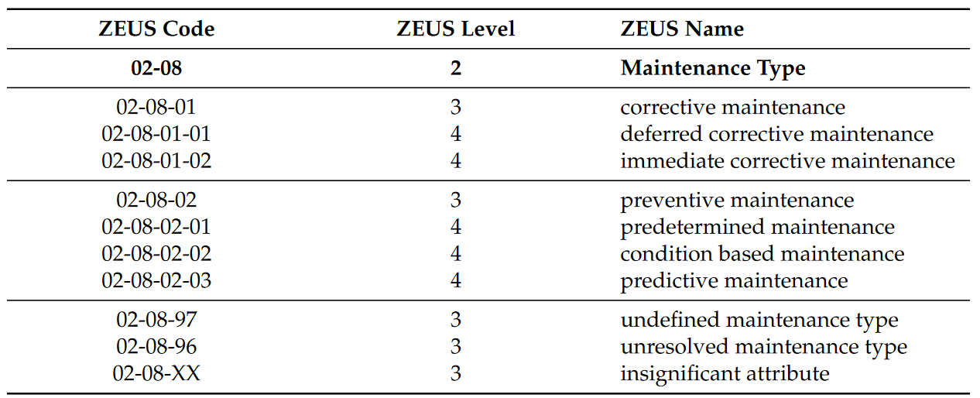
Method
ZEUS
We use the ZEUS classification system for maintenance types (“Zustand-Ereignis-Ursachen-Schlüssel”)
MWOs are labeled manually by experts
Labels are also used as ground truth for training and evaluation of the machine learning approach

Slide 5
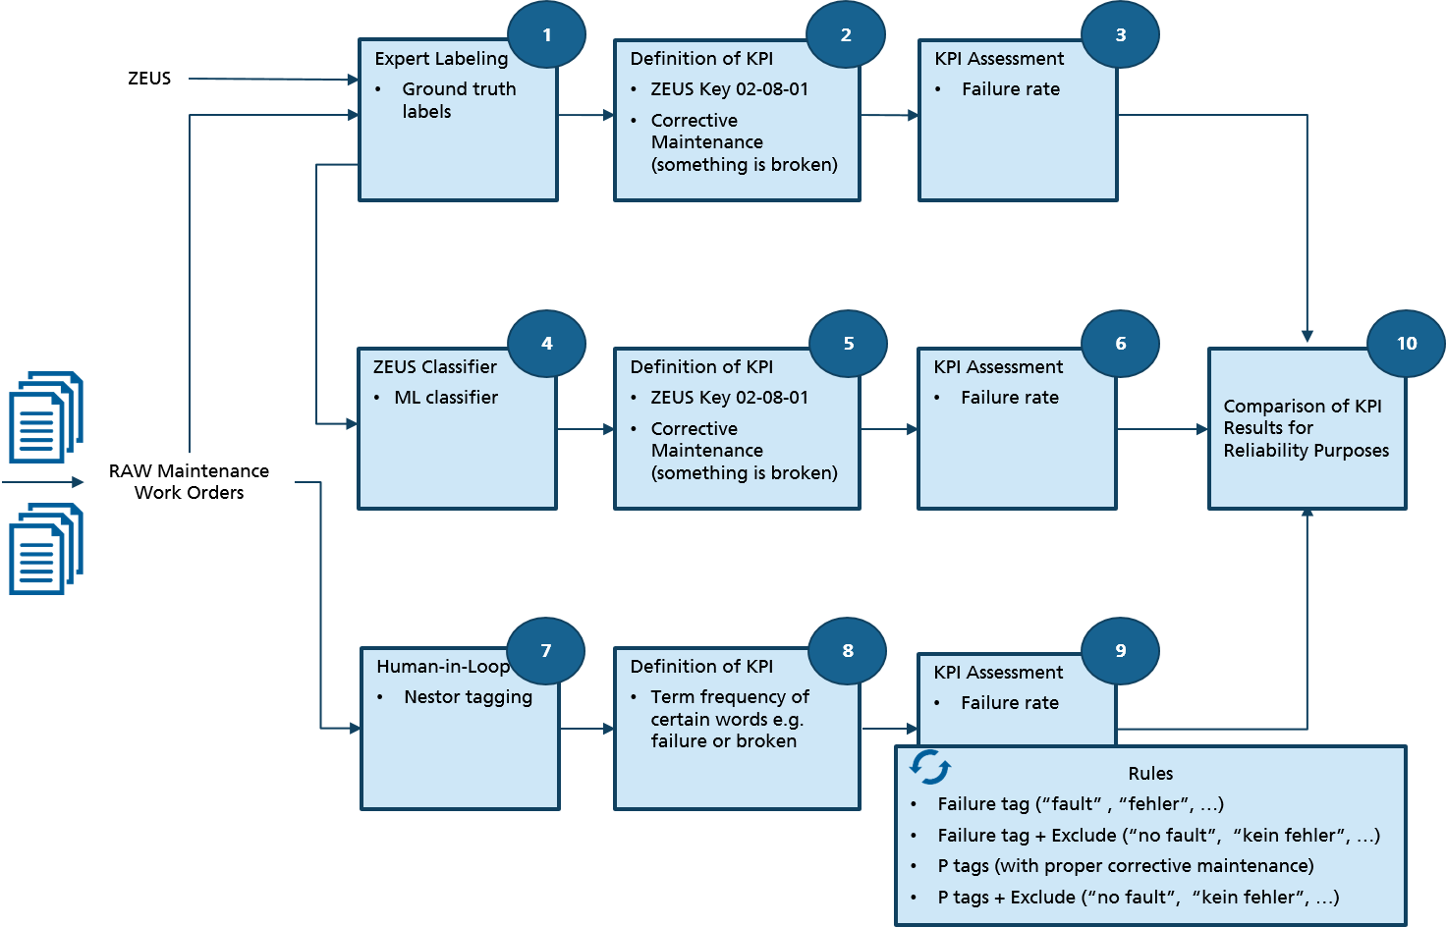
Method
Overview
We compares three different approaches to calculate reliability key performance indicators (KPI) from maintenance work orders:
Manual labeling by domain experts
Machine-Learning-based classification (logistic regression, naïve Bayes)
AI-assisted tagging using the tool “Nestor”

Slide 6
Method
AI-Assisted Tagging through Nestor
AI-assisted tagging with Nestor derives labels through a human-in-the-loop process, in which terms from maintenance work orders are tagged with and mapped to a common alias term.
E.g., “error”, “failure”, “fault” -> “failure”
Additionally, one of five entities can be assigned to terms:
“Problem”, “Solution”, “Item”, “Ambiguous”, “Irrelevant”
Nestor facilitates the tagging process by presenting only most relevant/discriminative terms
Ranked by term-frequency – inverse document frequency (TF-IDF) scores

Slide 7
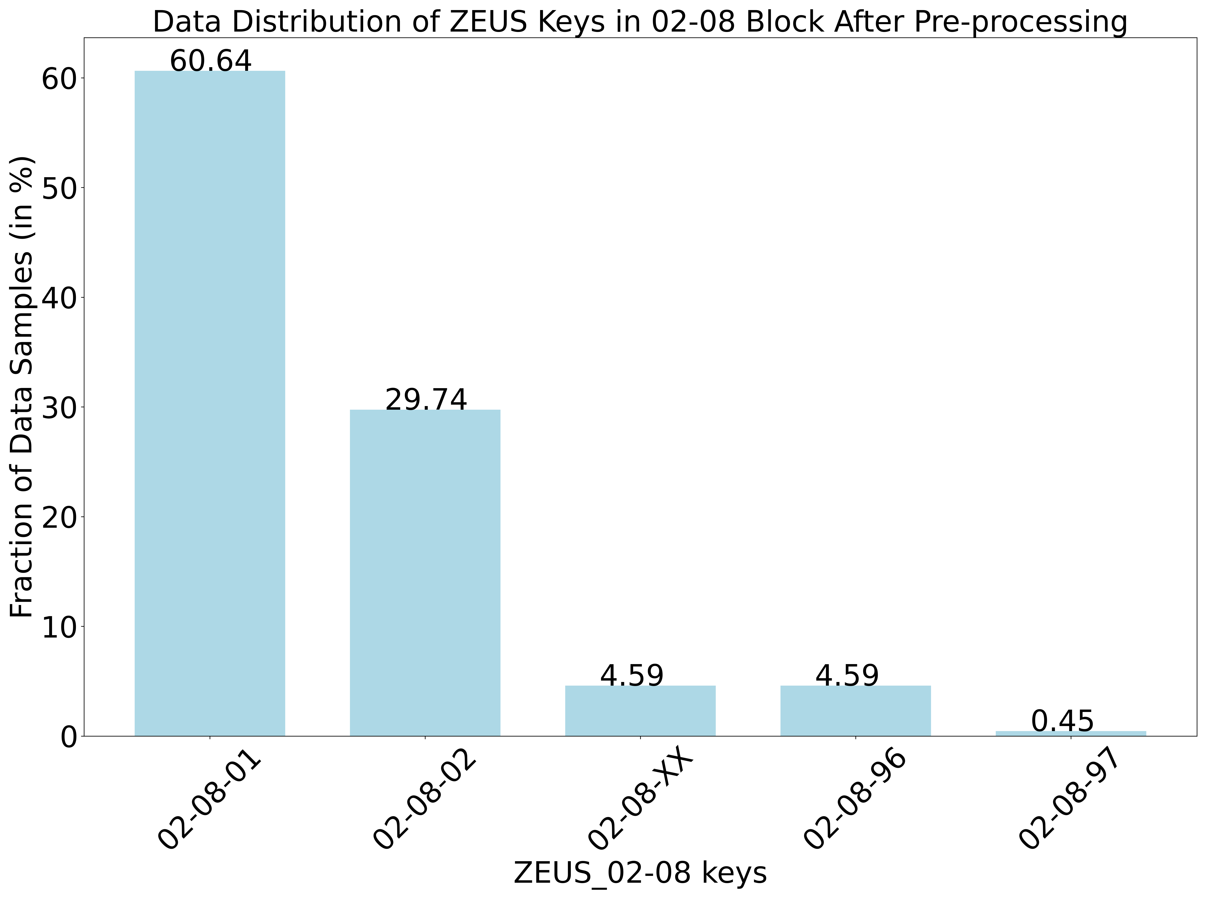
Method
Machine Learning Approach
MWO Preprocessing and Feature Extraction
Removal of stop words, numbers and punctuation
Removal of empty reports
Representation as TF-IDF vectors
Two well-established classification methods
Naïve Bayes
Logistic Regression
Two oversampling approaches are considered due to skewed class distribution
Random Oversampling
SMOTE

Slide 8
Method
KPI Calculation
We calculate the failure rate $λ_{Item}$ of an item as follows:
In our work, Item is the overall Wind Turbine
I.e., we do not differentiate between failure rates of individual components
However, approach would be similar (classify MWOs by RDS-PP instead of ZEUS)
For calculating times between failures, we use MWOs with the Corrective Maintenance class (in manual labeling and machine learning approach).
In AI-assisted tagging, MWOs with a Failure tag are considered (+ some rules, e.g., to exclude negations such as “no fault”).
Calculate the time difference between subsequent maintenance/failure events
$$λ_{Item}= \frac{1}{MTBF_{Item}}$$
$$MTBF_{Item}=\frac{\sum_{i=1}^{C_{F, Item} }{{Δt}_{Item,i}}}{C_{F, Item}}$$
${Δt}_{Item,i}$time to the ith failure of Item
$C_{F, Item}$ total number of failures of Item.

Slide 9
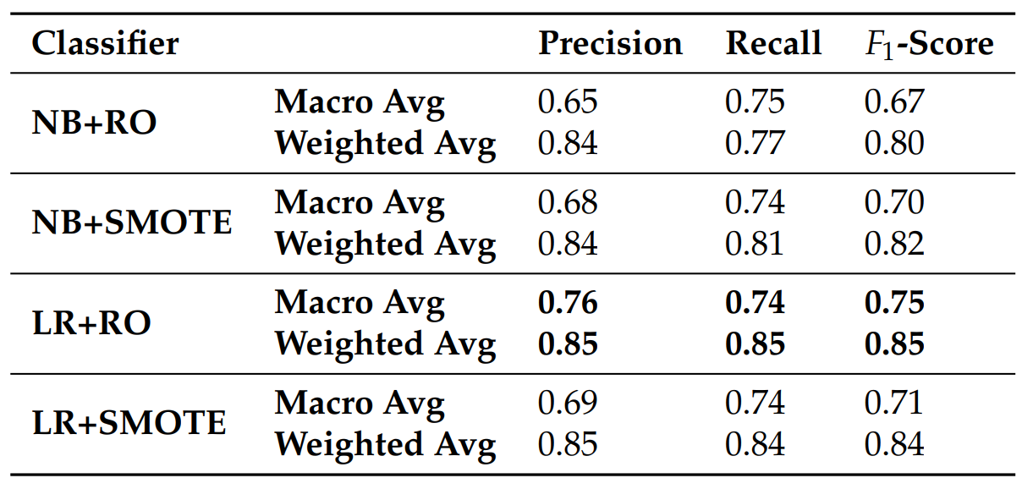
Evaluation
ZEUS Classification
We evaluate Precision, Recall and $F_{1}−$Score
Macro Average (average over class scores)
Weighted Average (by class frequencies)
Best results in both cases were achieved through logistic regression (LR) in combination with random oversampling (RO)

Slide 10
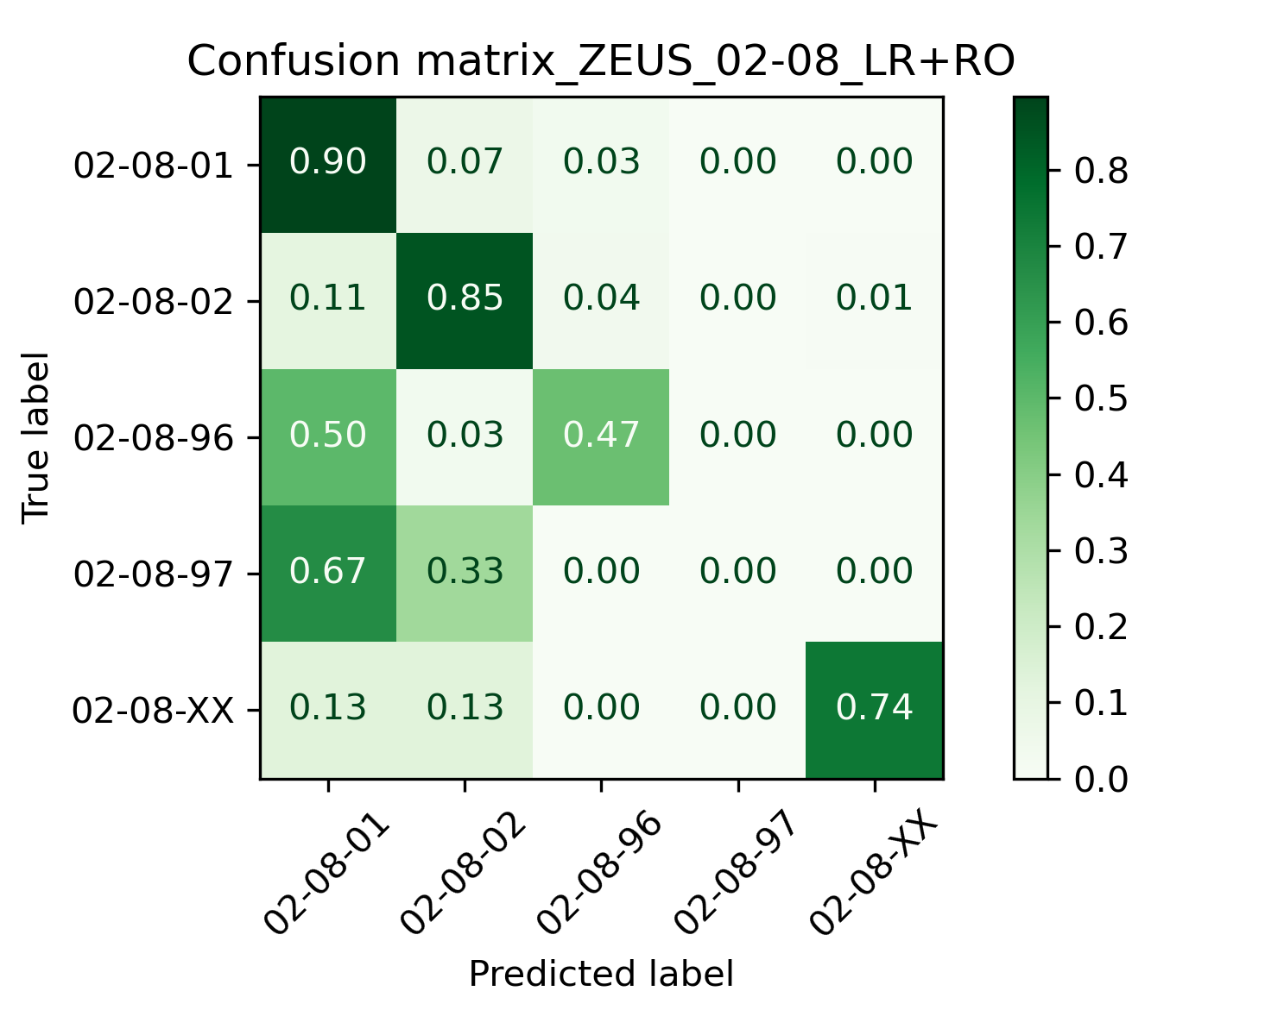
Evaluation
ZEUS Classification
A deeper investigation of the approach reveals that classes with few samples still pose a challenge

Slide 11
Evaluation
KPI Calculation
Dataset:
40 wind turbines of a single wind farm
01/2016 – 12/2020 (4 years)
~4k MWOs
We evaluate two factors for the three approaches:
Accuracy of the failure rate
Manual effort (tagging/labeling time)
Failure Rate of expert labeling is considered as ground truth for our MWO data set
For reference, we display wind turbine failure rates from literature (“Strathclyde”)
[1]
[1] Carroll, J.; McDonald, A.; McMillan, D. Failure rate, repair time and unscheduled O&M cost analysis of offshore wind turbines. Wind Energy 2016, 19, 1107–1119.

Slide 12
Evaluation
KPI Calculation
Overall, ML approach is closer to the ground truth (as well as to Strathclyde).
Nestor saves considerable amount of tagging time (88%).
Trade-off between tagging time and accuracy of KPI calculation for the investigated methods and data set
[1]
[1] Carroll, J.; McDonald, A.; McMillan, D. Failure rate, repair time and unscheduled O&M cost analysis of offshore wind turbines. Wind Energy 2016, 19, 1107–1119.

Slide 13
Conclusion & Outlook
Main Results
Trade-off between tagging time and accuracy of KPI calculation for the investigated methods and data set
Further investigations using Large Language Models might be promising in increasing accuracy further
May also enable applications in maintenance beyond KPI calculation (e.g., assistance for maintenance personnel)
Overall, our findings make extracting information from maintenance work orders more efficient, enable the assessment of reliability KPIs and support optimization of wind turbine maintenance.
[1]
[1] Carroll, J.; McDonald, A.; McMillan, D. Failure rate, repair time and unscheduled O&M cost analysis of offshore wind turbines. Wind Energy 2016, 19, 1107–1119.

Slide 14
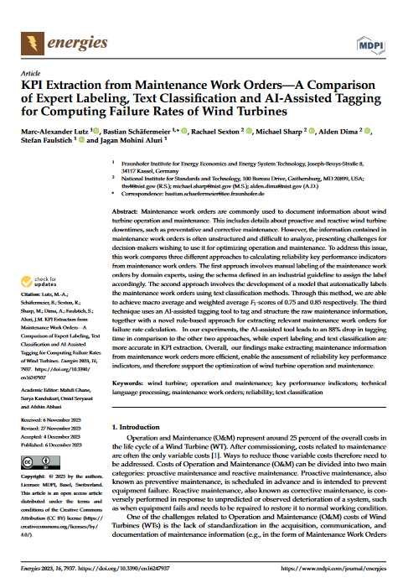
Questions?
Read Our Paper (+ Cite ☺)
Lutz, Marc-Alexander, Bastian Schäfermeier, Rachael Sexton, Michael Sharp, Alden Dima, Stefan Faulstich, and Jagan Mohini Aluri. 2023. "KPI Extraction from Maintenance Work Orders—A Comparison of Expert Labeling, Text Classification and AI-Assisted Tagging for Computing Failure Rates of Wind Turbines" Energies 16, no. 24: 7937. https://doi.org/10.3390/en16247937

