Slide 1
Darexa-F - DatenREduktion für EXascale-Anwendungen in der Fusionsforschung
Kick-off Meeting
Erwin Laure
2023-01-10

Slide 2





Partners - Introduction

Slide 3
Main Goals
Improve efficiency of data handling at Exascale
    Mixed precision; non-IEEE data formats
    Data compression
    Exploitation of novel hardware and memory/storage technologies
    Modelling and emulation
Co-design vehicle: GENE-code
Demonstrate results on largest supercomputers
    GCS/LRZ; NHR/FAU; MPG/MPCDF

Slide 4
Project Structure

Slide 5
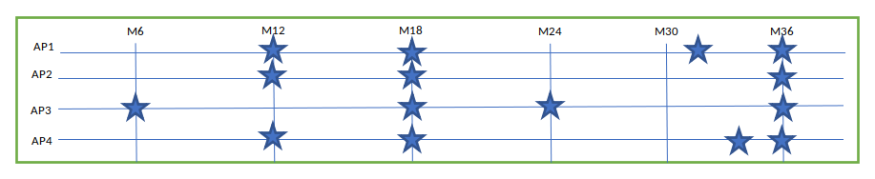
Project milestones

Slide 6
Agenda
09:50 Intro & Roundtable Erwin Laure (MPCDF)
10:10 Informationen vom Projektträger Gregor Schwartz (VDI/VDE)
10:40 AP1 - Reduced Precision Frank Jenko (IPP)
11:10 AP2 – Datenkomprimierung Tilman Dannert (MPCDF)
11:25 Break
11:55 AP3 - Performance Engineering Gerhard Wellein (FAU)
12:25 AP4 - Neuartige Architekturkonzepte Martin Schulz (TUM)
12:50 Discussion & Work Organization

Slide 7
Work Organization & Discussion

Slide 8
Work Organization
Collaborative tools
Coding tools
Web presence
Meetings

